Slide 1

Generative Adversarial Networks
Mirjam Nilsson​
By:
Vedansh Agrawal
Anush Anand
Shreya Bollimuntha

Slide 2

Introduction
We will be presenting the paper on Generative Adversarial Networks written by
Ian J. Goodfellow
Jean Pouget-Abadie
Mehdi Mirza
Bing Xu
David Warde-Farley
Sherjil Ozair
Aaron Courville
Yoshua Bengio

Slide 3
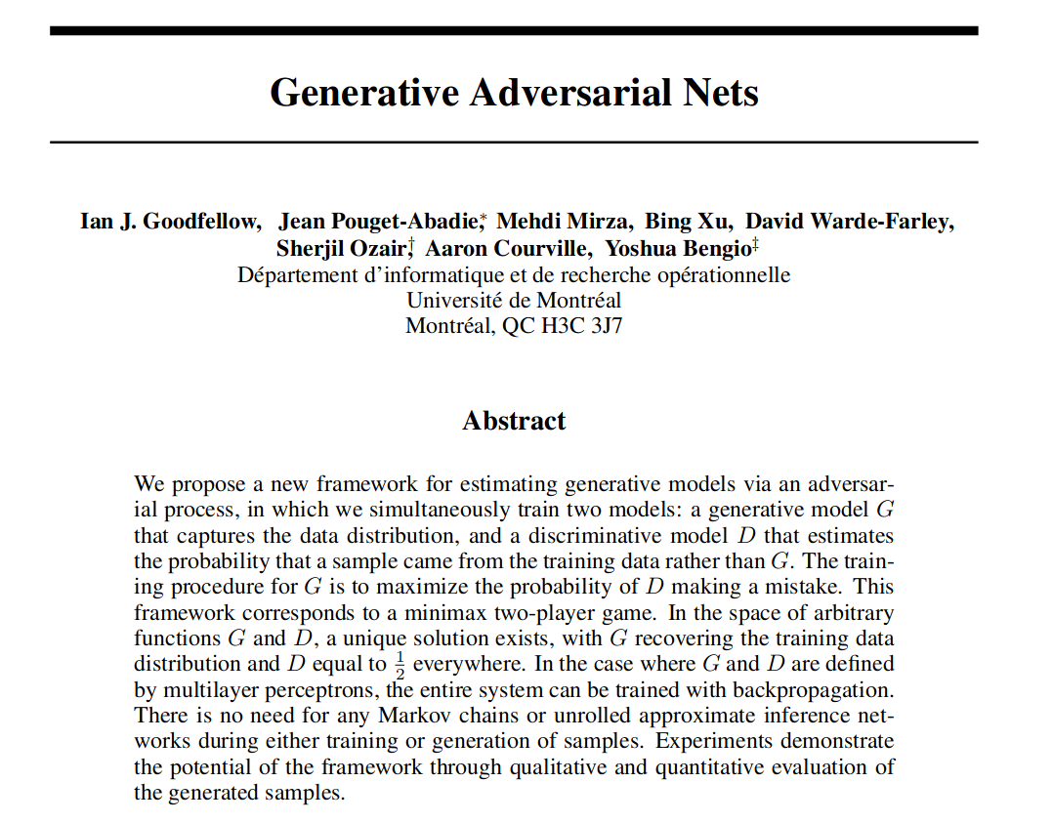

Slide 4
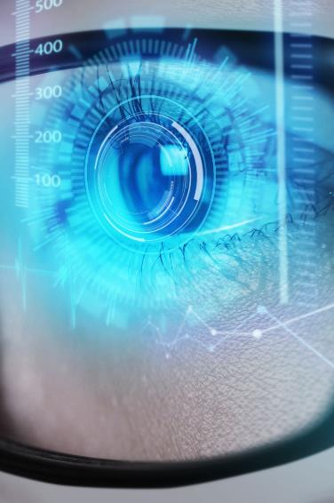
Motivation
Learning Distributions
Generative modeling
BackPropogation
The promise of deep learning is to discover models that represent probability distributions over the kinds of data encountered in artificial intelligence applications, such as natural images, audio waveforms containing speech, and symbols in natural language corpora.
Deep generative models have had less of an impact, due to the difficulty of approximating many intractable probabilistic computations that arise in maximum likelihood estimation and related strategies, and due to difficulty of leveraging the benefits of piecewise linear units in the generative context.
We can train both models using only the highly successful backpropagation and dropout algorithms and sample from the generative model using only forward propagation. No approximate inference or Markov chains are necessary.

Slide 5
PAST works
Generative stochastic network
The Generative Stochastic Network (GSN) framework represents a notable contribution, extending the concept of generalized denoising auto-encoders. GSNs essentially define a parameterized Markov chain, wherein the machine learns parameters to execute one step of a generative Markov chain.
Noise-Contrastive Estimation (NCE) and Discriminative Training:
NCE introduces a discriminative training criterion, utilizing the generative model itself for discrimination tasks. Notably, unlike other methods, NCE doesn't require a separate discriminative model but employs the generative model to distinguish generated data from samples of a fixed noise distribution.

Slide 6

Adversarial Nets
In the proposed adversarial nets framework, the generative model is pitted against an adversary which is the discriminator.
The job of the generator is to mimic the distribution of the dataset given.
The discriminator learns to determine whether a sample is from the model distribution or the data distribution.
The generative model can be thought of as analogous to a team of counterfeiters, trying to produce fake currency and use it without detection, while the discriminative model is analogous to the police, trying to detect the counterfeit currency.
Competition in this game drives both teams to improve their methods until the counterfeits are indistinguishable from the genuine articles.
Generated by GAN

Slide 7

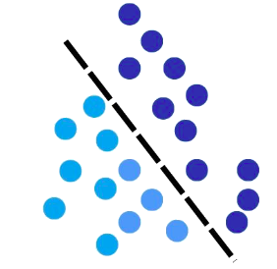
What does it contain?
GENERATOR
DISCRIMINATOR
This model takes in a prior noise distribution p_{z}(z) generates a distribution p_{g}. We represent a mapping to a data space as G(z:θ_{g}) where the θ_{g} is parameters of the model .
This model outputs a single scalar value. It is represented as D(x; θ_{d}) and D(x) is the probability that x came from the data rather than generative distribution p_{g}.

Slide 8
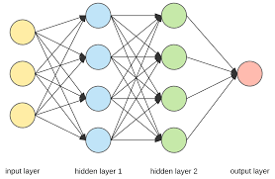
Discriminator
Purpose
Distinguishes between real data and generated data produced by a generator.
Modeled using a Multilayer Perceptron (MLP) neural network.
Architecture
Represents a binary classifier which receives inputs of distribution and outputs if the distribution is real or fake.
Utilizes a differentiable function where D(x;θ_{d}) where θ_{d} is parameters of discriminator

Slide 9
Discriminator TRAINING
Input
Receives input data samples from real data examples from the dataset and generated data produced by generator.
Labels
They are 2 types of labels here:
Real Labels : The labels to the data generated from real data examples
Fake Labels : The labels to the data generated from the fake data examples
This forms the basis for the binary classification
OPtimization objective
Aims to maximize the probability of correct classification so in other words:
We maximize probability of real data or D(x) . (real data)
We minimize probability of fake data or D(G(z)). (fake data)

Slide 10
Discriminator LOSS
LIKELIHOOD
The likelihood of the data here is
max_{D} V (D, G) = E_{x~pdata(x)} [log D(x)] + E_{z~pz(z)} [log(1 - D(G(z)))]
Here we are maximizing 1 - D(G(z) because its same as minimizing D(G(z))
And the logarithm is used here because its monotonically increasing function so maximum likelihood estimation
Is same as maximum log likelihood estimation

Slide 11
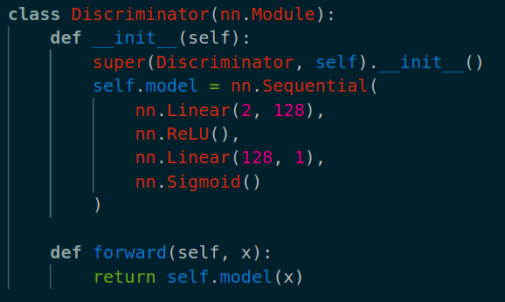
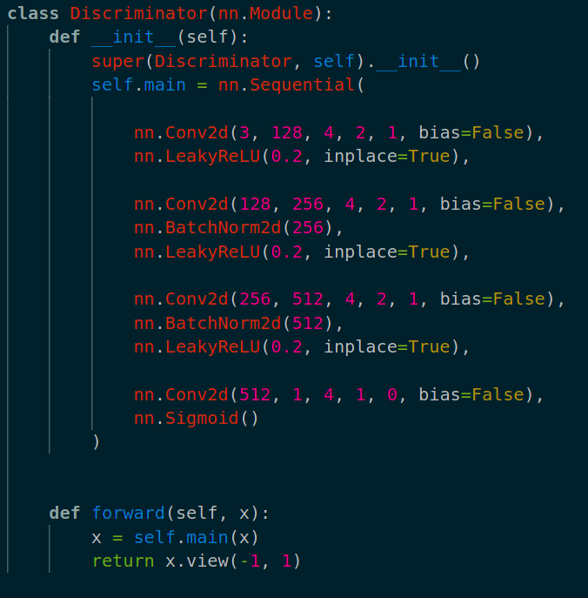
Discriminator Code snippet

Slide 12
Generator
Purpose
Here we create a synthetic data resembling the real data distribution from a prior noise distribution.
Architecture
A model which receives inputs of random noise and outputs a distribution.
Utilizes a differentiable function where G(z;θ_{g}) where θ_{g} is parameters of generator
It has a Layered Structure,
Comprises multiple interconnected layers:
Input layer: Receives noise vector (z).
Hidden layers: Process and transform the input noise.
Output layer: Generates synthetic data.

Slide 13
Generator TRAINING
Input
Receives random noise vector (z) from a prior distribution (p_{z}(z)).
Maps noise to data space using differentiable function G(z; θ_{g} ).
Optimization objective
Maximizes the D(G(z)). Or in the other words minimizes 1-D(G(z))
Focuses on fooling the discriminator (D) by generating data indistinguishable from real data.
LOSS
min_{G} V (D, G) = E_{z~pz(z)} [log(1 - D(G(z))]
Here we are minimizing the log the value value. This is the loss our model wants to minimize

Slide 14
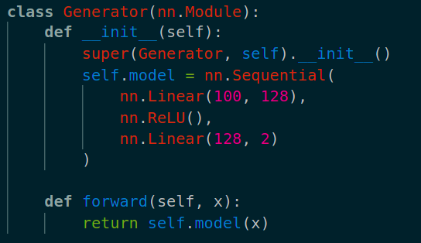
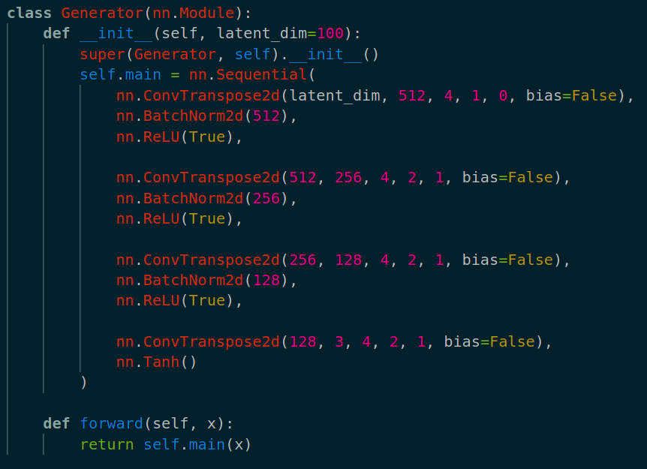
Generator code snippet

Slide 15
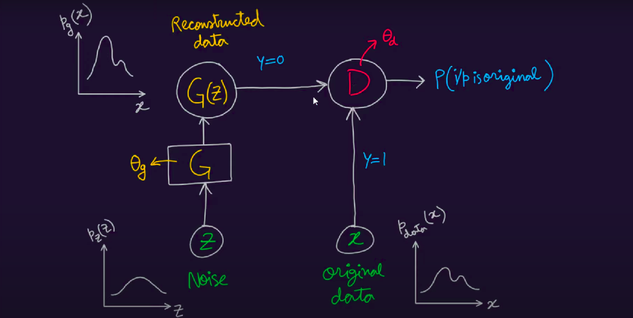
Combining the two
Now we can combine the loss function of the generator as well as the discriminator to obtain one equation which shows D and G playing the following two-player minimax game with value function V (G, D)
Optimizing the Discriminator completely in the training loop is computationally prohibitive and can result in overfitting.
Instead, what we do is alternate between k steps of optimizing D and one step of optimizing G.
This causes D being maintained near its optimal solution, so long as G changes slowly enough. If G becomes better than D from the beginning the D won't be able to learn to distinguish between real and fake distributions.
min max V (D, G) = E_{x~pdata(x)}[log D(x)] + E_{z~pz(z)}[log(1 - D(G(z)))].
G
D

Slide 16
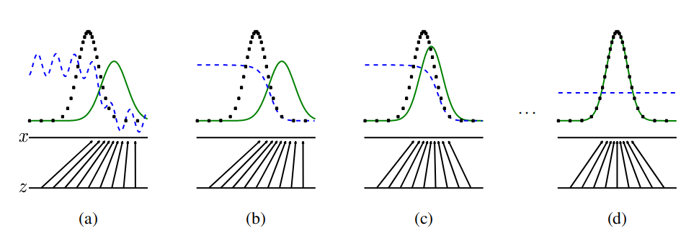
An alternate approach
The figure below visualizes the manner in which both models improve. In the figure
Discriminative distribution: (D, blue, dashed line)
Generative distribution: (G, green, solid line)
Lower horizontal line: Domain where z is sampled
Upper horizontal line: Domain of the distribution of x
Here (a) represents initial random D model that’s why its vague then for a fixed G we learn D in (b) then using learnt D we learn G in (c) and doing this continuously we reach (d)
However, over time, the generator learns to mimic the data distribution and the discriminator is unable to distinguish between real and fake.

Slide 17
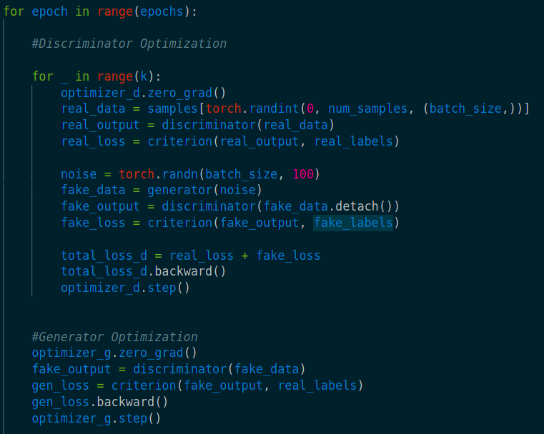
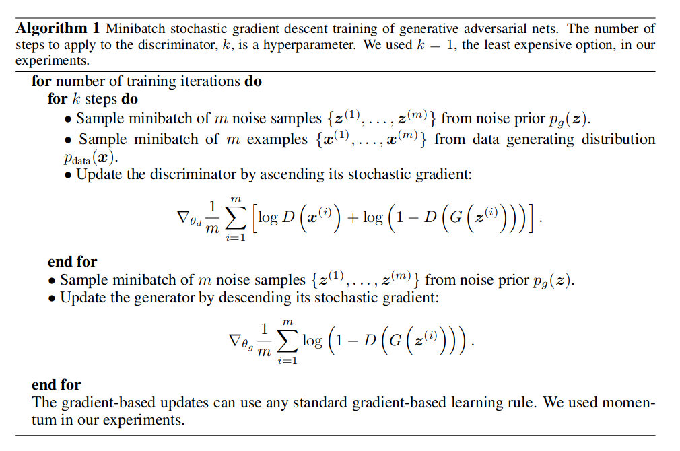
Training algorithm

Slide 18
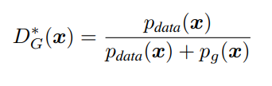
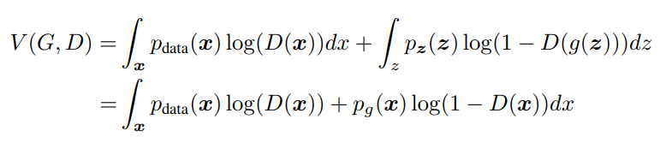
Theoretical results
Optimizing DISCRIMINATOR WITH FIXED GENERATOR
Proposition 1: Optimizing Discriminator with Fixed Generator
The Optimal Discriminator Equation:
Proof: For a fixed generator G, the optimal discriminator maximizes the quantity V(G, D).

Slide 19
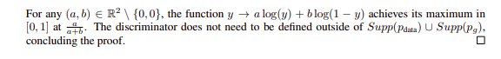
Theoretical results
Optimizing DISCRIMINATOR WITH FIXED GENERATOR
The training objective for D can be interpreted as maximizing the log-likelihood for estimating the conditional probability P(Y = y|x), where Y indicates whether x comes from p_{data} (with y = 1) or from p_{g} (with y = 0). The minimax game can now be reformulated as:

Slide 20
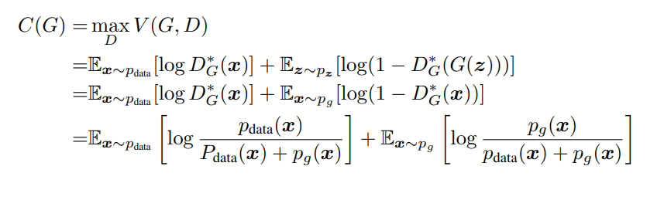
Theoretical results
Reformulation of the Minimax game:
Conclusion: The optimal discriminator's formulation maximizes log-likelihood to discern between real and generated data. Essential for achieving equilibrium in the adversarial learning process between G and D.

Slide 21
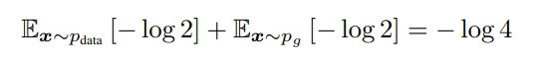
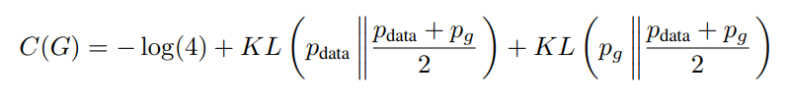
Theoretical results
Global optimality of p_{g} = p_{data}
Theorem 1: The global minimum of the virtual training criterion C(G) is achieved if and only if p_{g} = p_{data}. At that point, C(G) achieves the value − log 4.
Proof: For p_{g} = p_{data}, the optimal discriminator D∗_{G}(x) = 1/2 Substituting D*_{G}(x) = 1/2 into C(G) yields C(G) = -log 4.
Optimality of – log 4: Best possible Value of C(G) By subtracting this from C(G) = V (D∗_{G}, G) we obtain

Slide 22
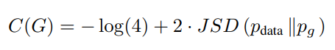
Theoretical results
Interpreting the Result: Jensen- Shannon Divergence Jensen–Shannon divergence is non-negative, achieving zero only when distributions are identical.
Conclusion: C∗ = - log(4) as Global Minimum: Achieved when p_{g} = p_{data}. Demonstrates that the generator perfectly replicates the data generating process to attain the minimum value of the training criterion.

Slide 23
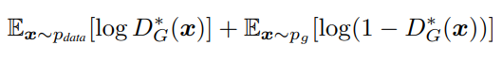
Theoretical results
Convergence of algorithm 1
Proposition 2: If G and D have enough capacity, and at each step of Algorithm 1, the discriminator is allowed to reach its optimum given G, and pg is updated so to improve the criterion then p_{g} converges to p_{data.}
Proof: Consider V(G, D) = U(p_{g}, D) as a function of p_{g}. Noting that U(p_{g}, D) is convex in p_{g}. Convexity and Subderivatives Convexity property: Subderivatives of a supremum of convex functions. The derivative at the maximum point is included in the subderivatives. Gradient Descent Update Equivalence to Gradient Descent: Update for p_{g} at optimal D given G. sup_{D}U(p_{g}, D) is convex in p_{g} with a unique global optima (Theorem 1).
Convergence of p_{g} With sufficiently small updates of p_{g} , p_{g} converges to p_{x}, the data distribution.

Slide 24
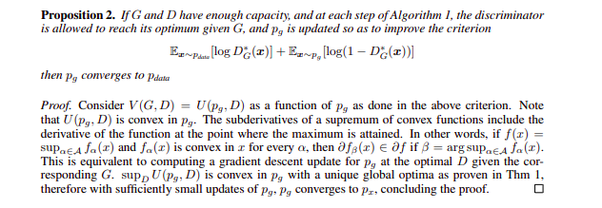
Theoretical results

Slide 25
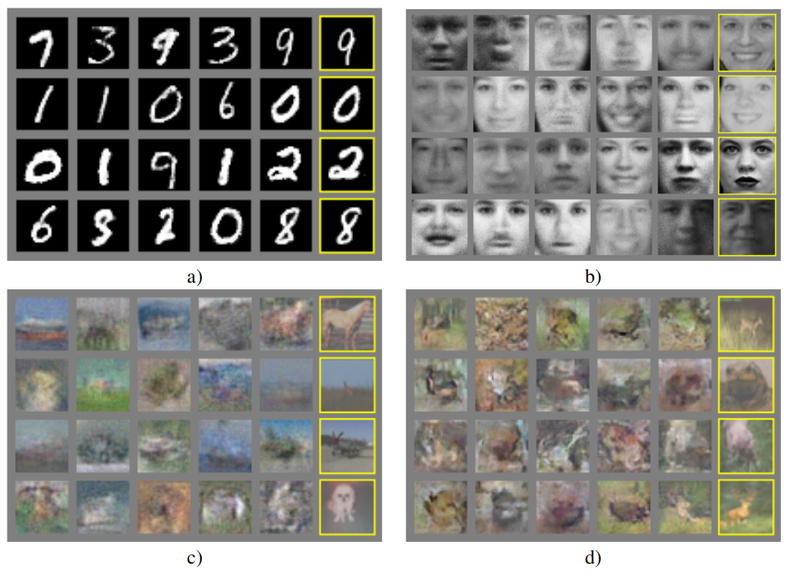
Experimental results

Slide 26
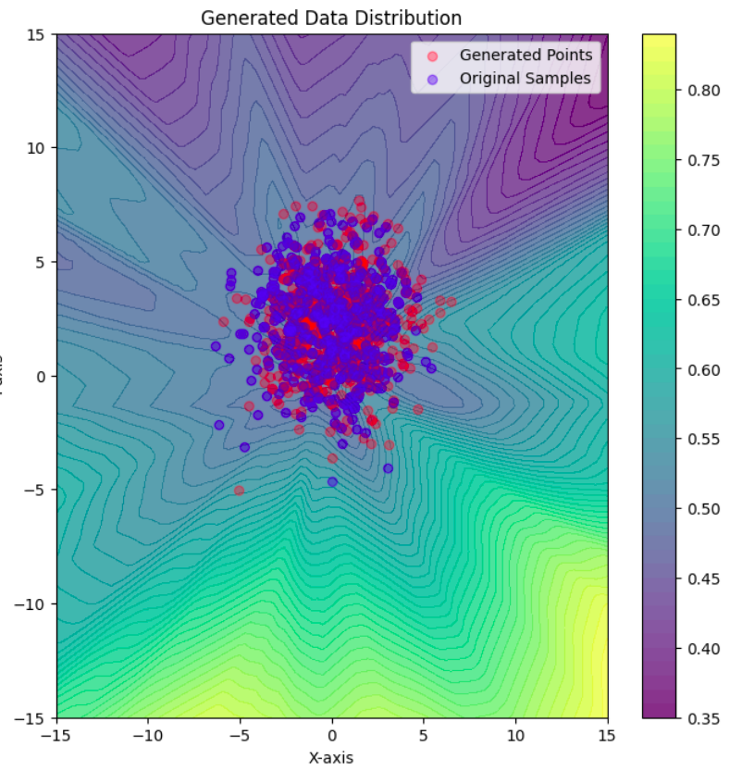
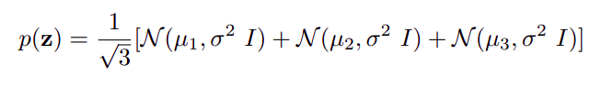
Our Results
Above is the distribution we trained our GAN to learn using MLP for our generator and discriminator
As we can see from the plot to our left, the generated points and actual datapoints appear to be from the same distribution.

Slide 27
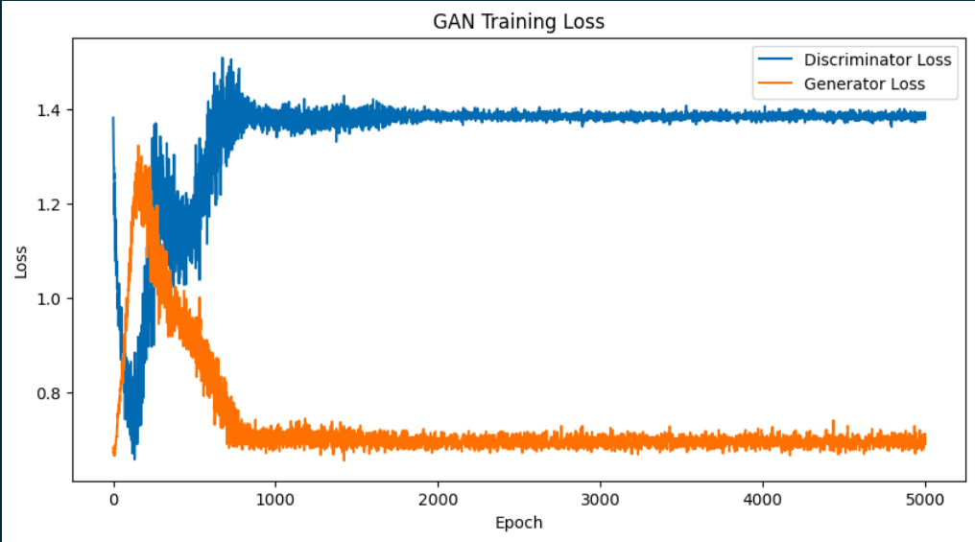
Loss vs epoch

Slide 28
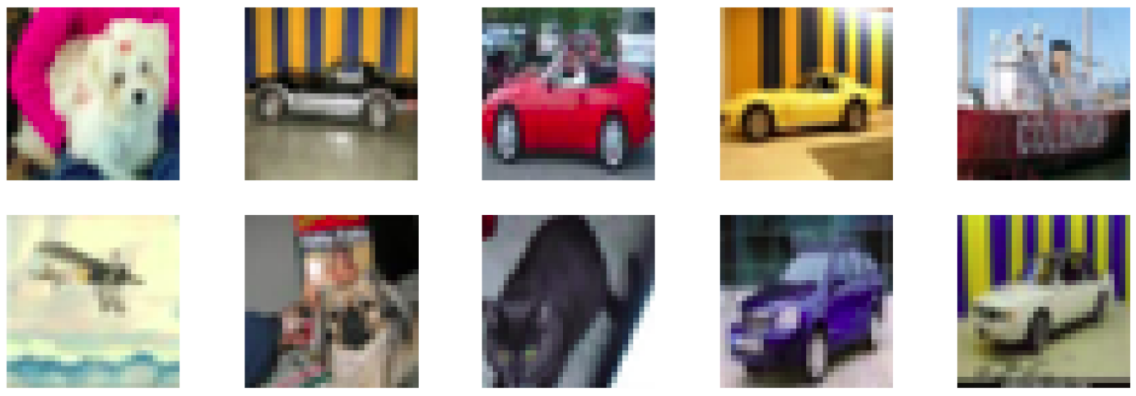
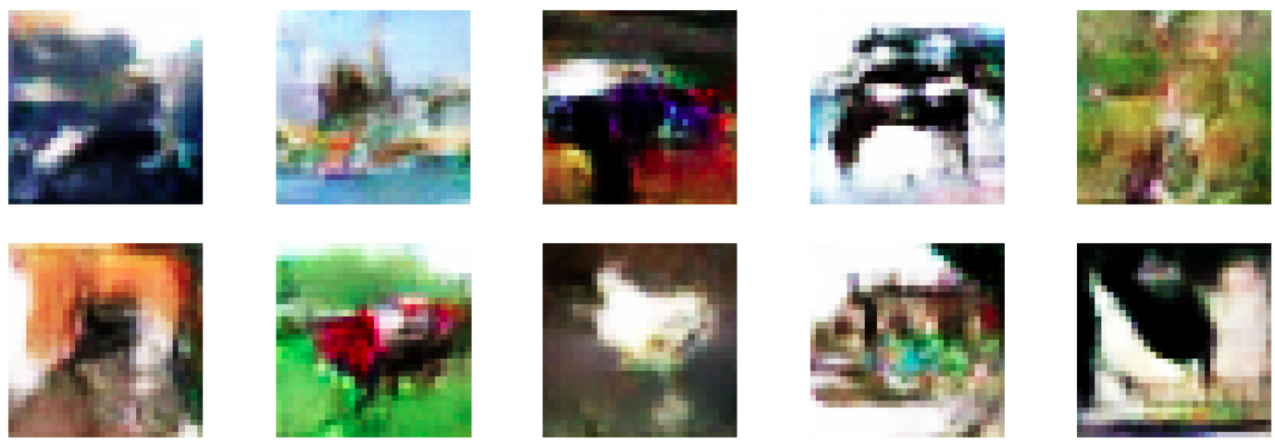
Our results
Actual Images sampled randomly from the CIFAR10 dataset.
Images generated using the GAN architecture which is made using convolutional layers.

Slide 29
Advantages and disadvantages
advantages
disadvantages
Markov chains are never needed, only backprop is used to obtain gradients, no inference is needed during learning
The generator network does not update directly with data examples, but only with gradients flowing through the discriminator. This means the generator will not overfit the data.
They can represent very sharp, even degenerate distributions
there is no explicit representation of p_{g}(x)
D must be synchronized well with G during training, we do not want the generator to be trained more than the discriminator otherwise the discriminator will be unable to learn to discriminate. This is called the “Helvetica scenario”

Slide 30

Conclusion & Future Work
This framework admits many straightforward extensions:
A conditional generative model p(x | c) can be obtained by adding c as input to both G and D.
Training could be accelerated greatly by divising better methods for coordinating G and D or determining better distributions to sample z from during training.
Features from the discriminator or inference net could improve performance of classifiers when limited labeled data is available.

Slide 31

Thank you

